Slide 1
Topic: Describing a distribution of scores.
EQ: How do I describe a distribution of scores?

Slide 2
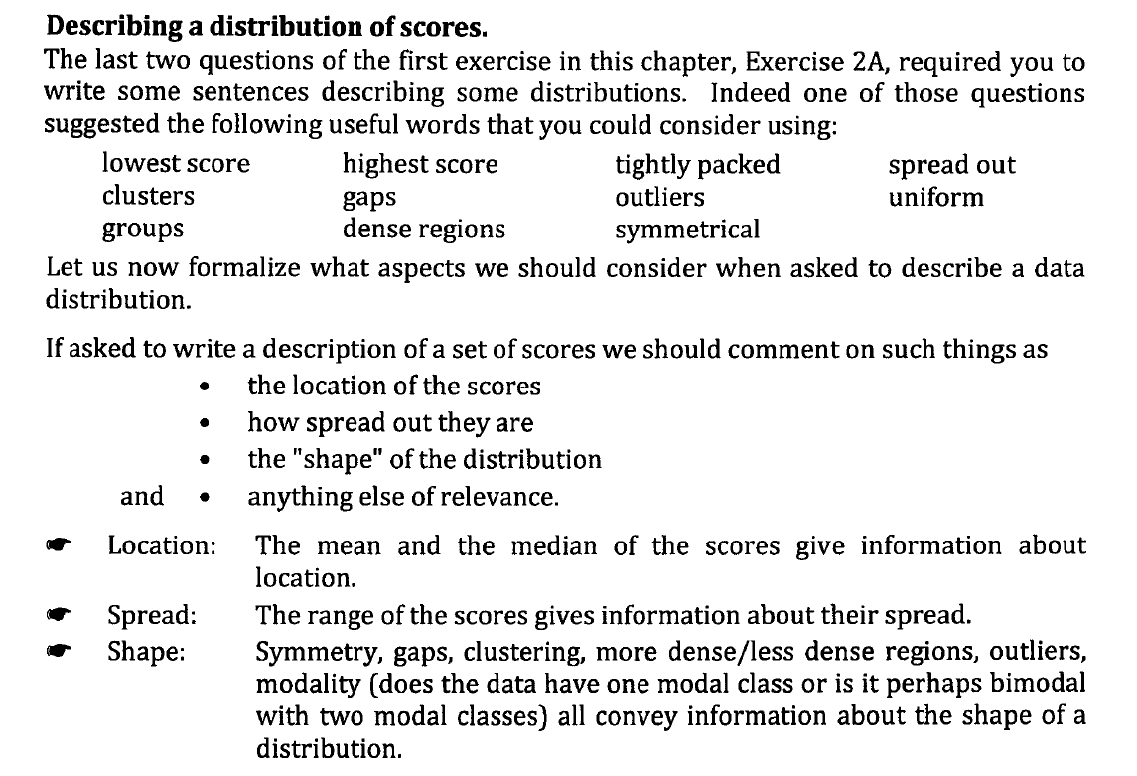

Slide 3
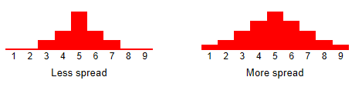
Location
The spread of a distribution refers to the variability of the data. If the observations cover a wide range, the spread is larger. If the observations are clustered around a single value, the spread is smaller.

Slide 4
Spread
The spread of a distribution refers to the variability of the data. If the observations cover a wide range, the spread is larger. If the observations are clustered around a single value, the spread is smaller.

Slide 5
Shape
Symmetry: Is the shape of the distribution symmetric, that is, is the shape similar either side of a central axis (like a mirror image)? Or is the shape skewed, that is, asymmetric?
Number of peaks: Distributions can have few or many peaks. Distributions with one clear peak are called unimodal (one mode), and distributions with two clear peaks are called bimodal (two modes). Distributions with more than two clear peaks are called multimodal (three or more modes). When a symmetric distribution has a single peak at the center, it is referred to as bell-shaped.

Slide 6
Shape
Skewness: When they are displayed graphically, some distributions have many more observations on one side of the graph than the other. Distributions with fewer observations on the right (toward higher values) are said to be skewed right; and distributions with fewer observations on the left (toward lower values) are said to be skewed left.
Uniform: When the observations in a set of data are equally spread across the range of the distribution, the distribution is called a uniform distribution. A uniform distribution has no clear peaks.

Slide 7
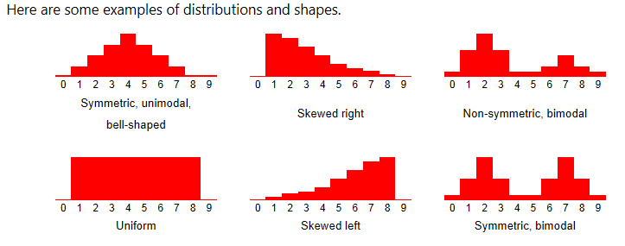

Slide 8
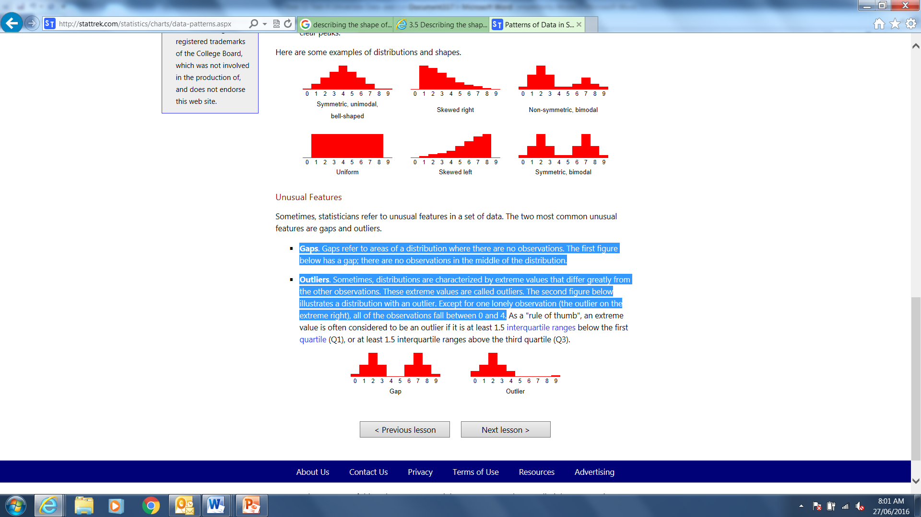
Shape
Gaps. Gaps refer to areas of a distribution where there are no observations. The first figure below has a gap; there are no observations in the middle of the distribution.

Slide 9
Shape
Outliers. Sometimes, distributions are characterized by extreme values that differ greatly from the other observations. These extreme values are called outliers. The second figure below illustrates a distribution with an outlier. Except for one lonely observation (the outlier on the extreme right), all of the observations fall between 0 and 4.

